Slide 1

NYPD Stop And Frisk Data Analysis
ALY6015-21454: Intermediate Analytics
Professor: Prof. Roy Wada
Submitted by: Group 4
Amryta Panda
Bennett Furman
Durga Bhanu Nayak

Slide 2

What is Stop and Frisk Policy?
Introduced in 1968, enabling a police officer to stop and question a person with reasonable suspicion
Meant to prevent any unlawful activities
Frisking is done to check for any possible illegal weapons or contrabands to be found
Down the year, this policy was being claimed as racist activity, specially the black race harassment

Slide 3
Data Overview
Data Properties:
Precinct level count data
Year range: 2003-2015
No Null values
Gender: Male/ Female
Races Analyzed during stops:
Black African American
White
Hispanic (Black/White)
Asian and Pacific Islander
American Indian and Alaskan Native
Data Grouping by Variables:
Year
Precinct
Sex
Race

Slide 4
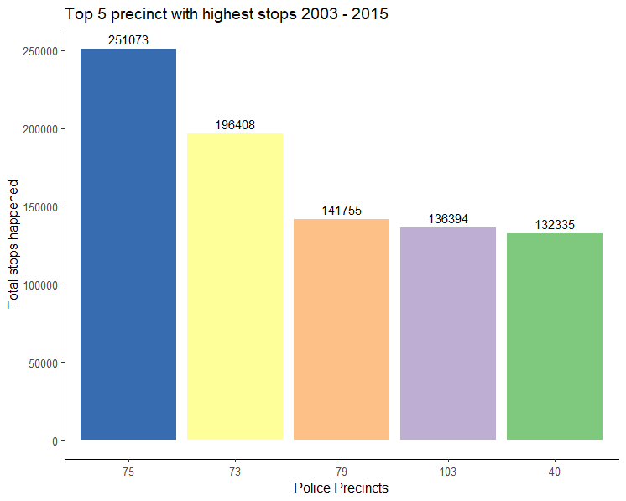
Which precincts are with the Highest stops?
The graph discusses the total stops happened at each police precinct.
The highest number of stops is observed at precinct 75, East New York.
The 2nd highest population were stopped at precinct 73, Ocean Hill Brownsville.
The 3rd highest stopped at precinct 79, Bedford-Stuyvesant.

Slide 5
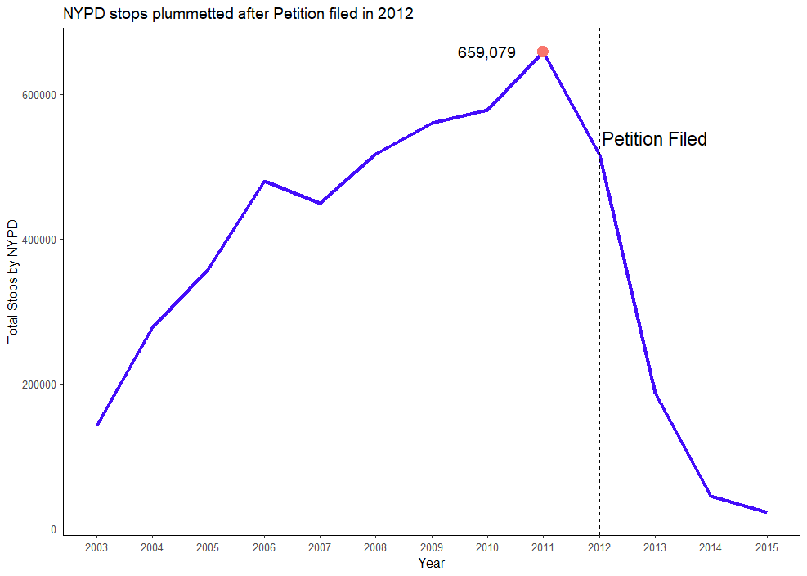
Rise and Fall of this policy usage
Since 2003, gradual increment in the stops can be seen till 2011
Around 650K people were stopped in New York across precincts
Many Civil rights organizations voiced against this policy
As soon, petitions were filed, overall “stops” got plunged in number

Slide 6
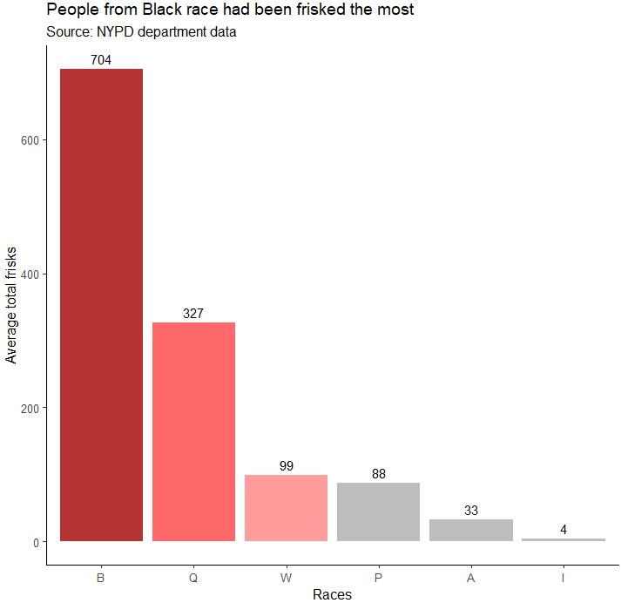
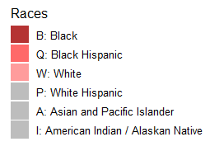
Most affected races from Stop and Frisk policy in NY
People from Black and Black-Hispanic race was worst affected from this stop and frisk policy
On an average, people from Black race are getting frisked more than six times higher than people from other races

Slide 7
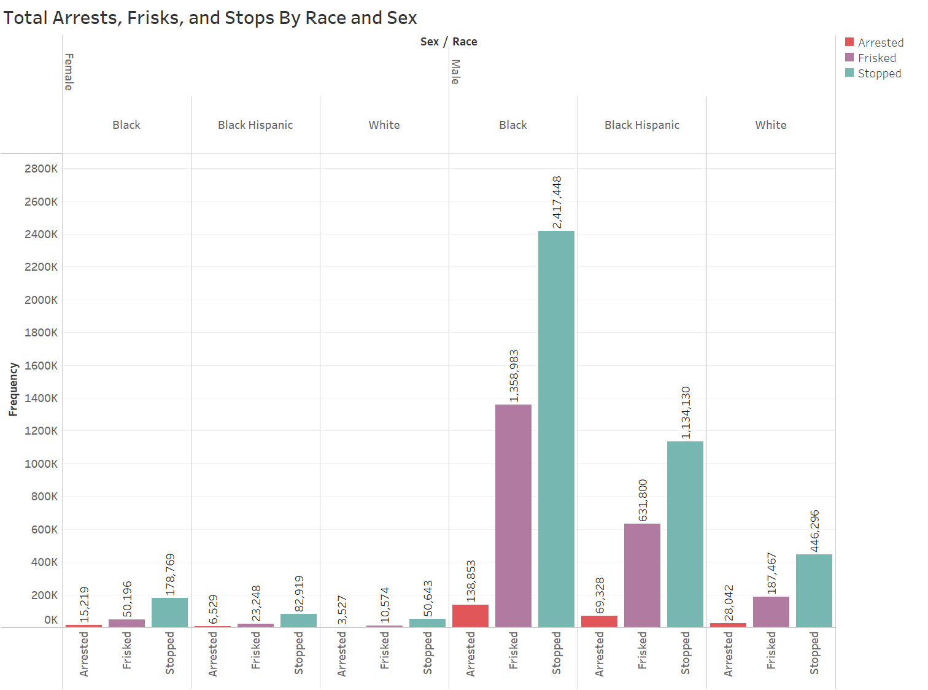
How do arrests, frisks, and stops compare for Black, Black Hispanic, and White men and women?
Female on left and male on right
Just Black, Black Hispanic, and White races
Black males have highest arrests, frisks, and stops
White women arrested, frisked, and stopped the least

Slide 8
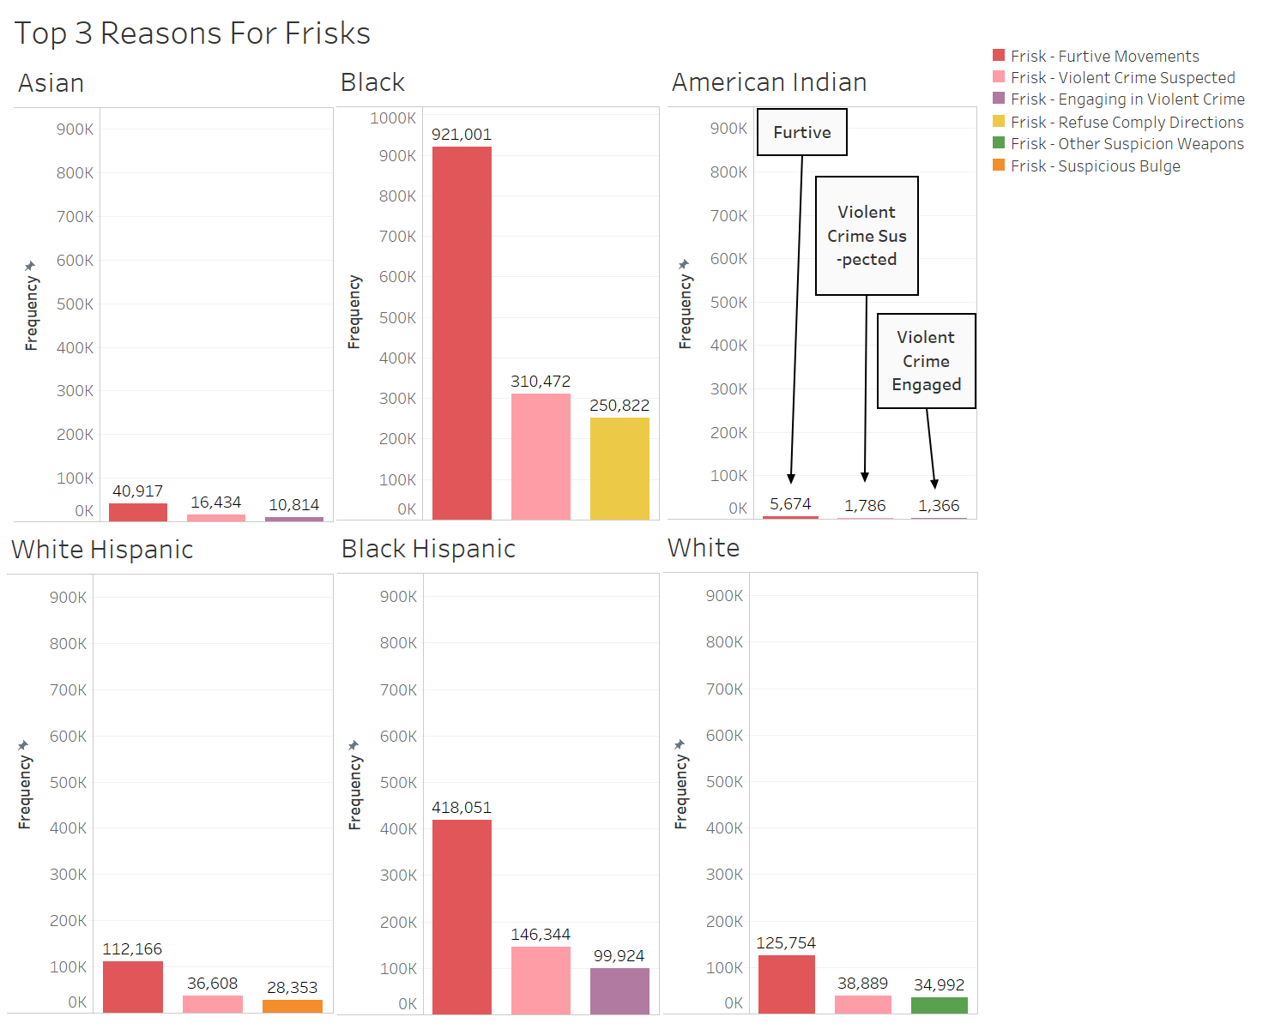
What are the top 3 reasons for frisks by race?
Furtive movements are highest reasons for frisks
Scale for Black race goes above 900,000
Frisk due to suspected violent crime is second for all races
Frisk due to engaging in violent crime is third highest for Asian, American Indian, and Black Hispanic
Frisks due to refusal to comply with officer, suspicious bulge, and other suspicion of weapons only show up for Black, White Hispanic, and White races

Slide 9
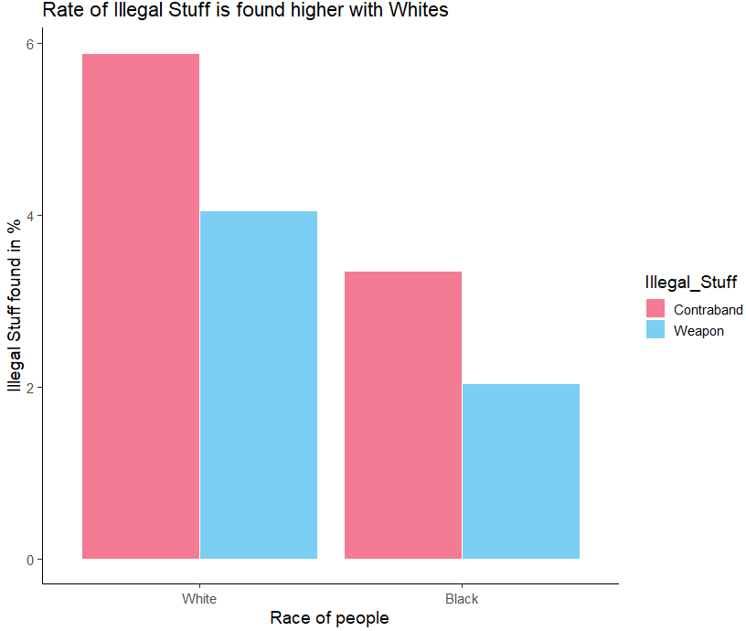
Is this policy really working as expected?
Race - White
Race - Black
Total frisked
198,041
Total frisked
1,410,179
Weapons Found
4.05%
Weapons Found
2.04%
Contraband found
5.89%
Contraband found
3.35%

Slide 10
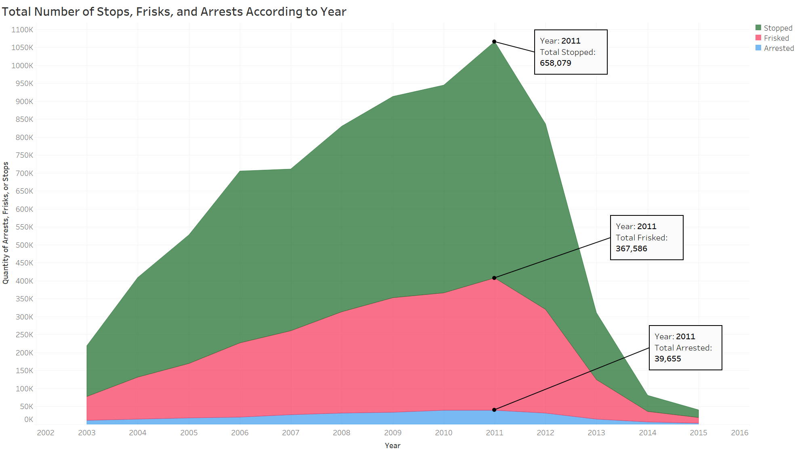
How do the numbers of stops, frisks, and arrests compare?
Stops largely outnumber frisks and arrests
Peak year for stops, frisks, and arrests was 2011
All three increased until 2011, right before the petition was filed
Small portion of stops result in arrests

Slide 11
Is the Frisk-to-Stop ratio statistically similar across races?
F- value | 91.05
Critical value | 2.997228
alpha | 0.05
P -value | <0.000000000000002
Performed ANOVA to compare the frisk to stop ratio among Black, Black-Hispanic and White races
Null Hypothesis = Average frisk to stop ratio is similar across races
Found significant difference among the average frisk to stop ratio for the races

Slide 12
Was there any change in frisking pattern among races after petition filed?
Observed drop in stops after 2012 petition
Performed Chi-squared test of independence to check frisking pattern difference among races for year 2011 and 2012
Null Hypothesis = Average frisk by year is independent of the races
Filed petition did made a change in frisking ratio among races
method | Pearson's Chi-squared test
Chi-squared Statistic | 1.465169
Critical Value | 11.0705
alpha | 0.05
p-value | 0.917054
Degree of Freedom | 5

Slide 13
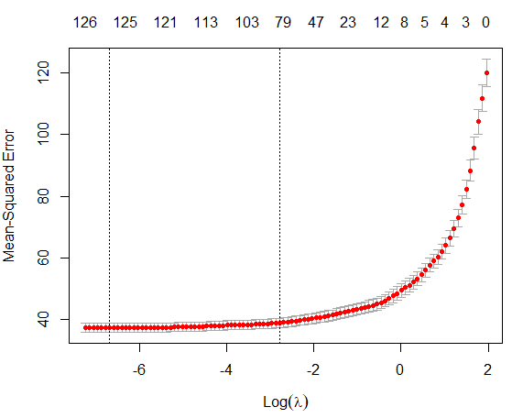
Predicting frisking proportion using Regression model
Grouped by year, precinct, and sex
Then found sum of stops and computed proportion of frisks to total stops
Compared with OLS model by selecting variables using best subset, all predictors were significant at .001 alpha level
Created training and test sets, then ran LASSO model
LASSO eliminated less significant predictors from model
Table of RMSE values:
 | OLS RMSE | LASSO RMSE
train predictions | 6.632 | 5.849
test predictions | 6.404 | 5.594

Slide 14
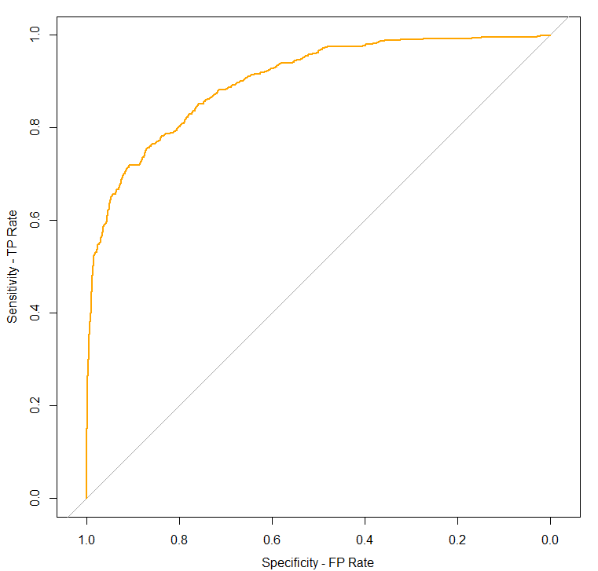
Determining the High and Low Frisking ratio
If frisk to stop ratio greater than or equal to .5 set binary variable to 1, else 0
Executed binomial glm with predictors like race, sex, furtive movements, attire, bulge, verbal threats, searched, weapon found, and others
Used model to make predictions on training and test sets
Performance metrics on training and test sets:
AuROC = 0.8103
 | Accuracy | Specificity | Precision | Recall
Training Set | 0.8595 | 0.6659 | 0.8532 | 0.9547
Test Set | 0.8537 | 0.6467 | 0.8554 | 0.9475

Slide 15
Conclusion
By analysis, we found that people of color were being worst affected by “Stop and Frisk” policy
Using ANOVA, we observed that average frisking ratio is not similar across races
At first this policy was made without any bias to prevent unlawful activities, later it was also being used for racial discrimination
People from “Black” race are being stopped and frisked much higher than other races
Proportion of illegal weapons and contraband found was higher in “White” race than “Black” when compared to the number of times they got frisked
Important variables to build model are race, gender, bulge spotted, description, furtive movements etc.

Slide 16
References
US Census Bureau. (2021, October 8). A More Diverse Nation. Census.Gov. https://www.census.gov/library/visualizations/2019/comm/age-race-distribution.html
Stop, Question And Frisk - CCRB. (2022). NYC CCRB. https://www1.nyc.gov/site/ccrb/investigations/stop-question-and-frisk.page
NYPD’s Infamous Stop-and-Frisk Policy Found Unconstitutional. (2019, March 15). The Leadership Conference Education Fund. https://civilrights.org/edfund/resource/nypds-infamous-stop-and-frisk-policy-found-unconstitutional/
Speri, A. (2021, June 10). The NYPD Is Still Stopping and Frisking Black People at Disproportionate Rates. The Intercept. https://theintercept.com/2021/06/10/stop-and-frisk-new-york-police-racial-disparity/

Slide 17
Thank You
For being a Great Audience
Any Queries?

